Slide 1
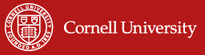
Index-Based Livestock Insurance:
The why and how of catastrophic drought insurance
Prof. Christopher B. Barrett, Cornell University
Presentation to Index-Based Livestock Insurance Stakeholders
Abuja, Nigeria
July 23, 2026

Slide 2
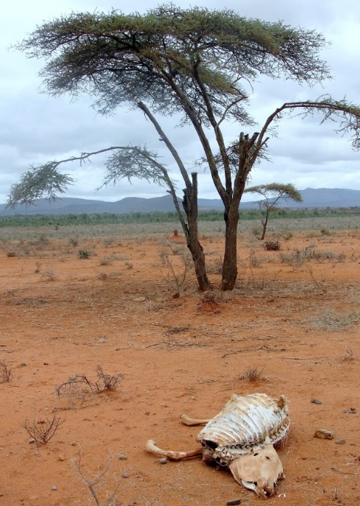
Why IBLI? Poverty Traps And Catastrophic Risk
Poverty traps exist in the arid and semi-arid lands (ASAL) of Kenya/Ethiopia. Catastrophic herd loss risk due to major droughts is the major cause of these dynamics. Puts a premium on drought risk management, both for individuals and for society.
Sources: Lybbert et al. (2004 EJ) and Santos & Barrett (2011 JDE, 2019 Barrett et al. UCP/NBER volume) on Boran in s. Ethiopia. Barrett et al. (2006 JDS), Chantarat et al. (2017 WD) for n. Kenyan pastoralists.

Slide 3
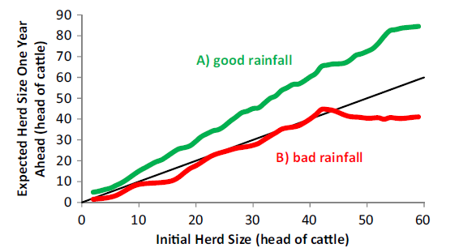
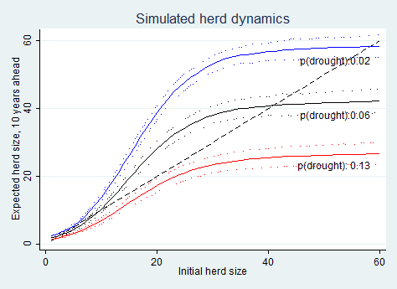
Why IBLI? Increased Risk From Climate Change
Are pastoralist systems resilient to rapid climate change? Many climate models predict increased rainfall variability (i.e., increased drought risk). Could it collapse the system w/o interventions?
Pastoralists’ herd growth expectations differ sharply b/n good and poor rainfall states. Herd dynamics change with drought risk.
In so. Ethiopia, in expectation, doubling drought risk leads to system collapse in the absence of any change to prevailing herd dynamics or drought responses.
Source: Barrett and Santos (Ecol Econ 2014, UCP chapter 2019)

Slide 4
Why IBLI? Standard Responses to Drought
Standard responses to major drought shocks:
1) Post-drought restocking: futile at low levels (Santos & Barrett 2019 chapter)
2) Food aid is slow, expensive, can reinforce sedentarization, high rates of excess mortality (Nikulov et al. PLoS ONE 2016)
Must address “the social protection paradox”: High social returns to insurance that keeps the non-poor from collapsing into a poverty trap. (Ikegami et al. 2019 UCP chapter)
Given herders’ self-insurance in kind, financial insurance can avert overstocking that causes rangelands degradation and/or broader migrations that spark inter-group conflict, and a vicious cycle of reinforcing feedback.

Slide 5
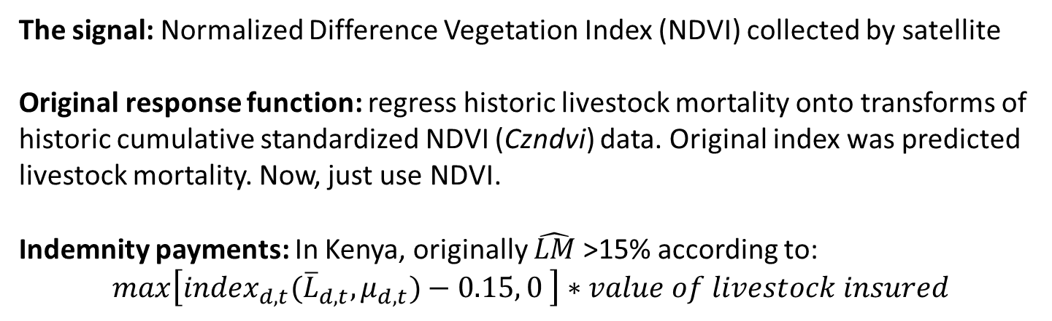
(Jensen, Barrett &2014)
How? Original IBLI Product Design
The signal: Normalized Difference Vegetation Index (NDVI) collected by satellite
Original response function: regress historic livestock mortality onto transforms of historic cumulative standardized NDVI (Czndvi) data. Original index was predicted livestock mortality. Now, just use NDVI.
Indemnity payments: In Kenya, originally $\hat{LM}$>15% according to:
$max\left[{index}_{d,t}({\overline{L}}_{d,t}, μ_{d,t})−0.15, 0 \right]∗value of livestock insured$
Temporal Structure of IBLI contract:
12-month contract sold during 2-mo sales windows just prior to usual start of seasonal rains. Payouts originally Mar 1 and/or Oct 1. Now earlier
Later updated to (i) pure NDVI play and (ii) payments early … asset protection vs. asset replacement design.
See Chantarat et al. JRI 2013; Jensen et al. Ecol Econ 2019; Fava & Vrieling COES 2021

Slide 6
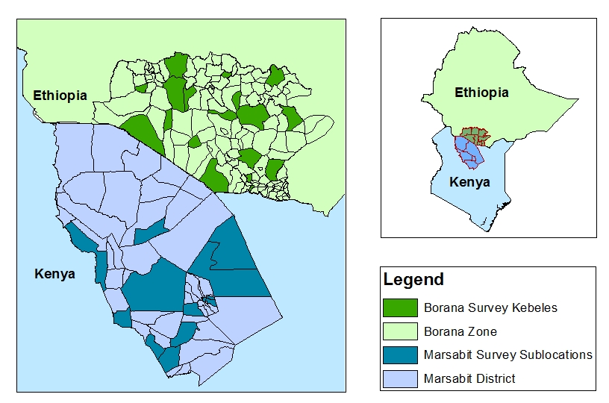
(Jensen, Barrett &2014)
How? Pilots in Ethiopia and Kenya
IBLI products (and IE surveys) launched in Marsabit, Kenya in Jan 2010 (Oct 2009) and in Borana, Ethiopia, in Aug 2012 (Mar 2012).
Kenya sampling overlaid with HSNP coverage and randomized premium discount coupon distributions as research design.

Slide 7
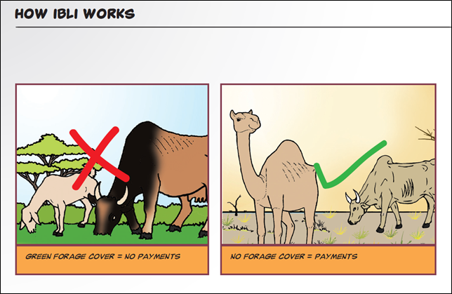
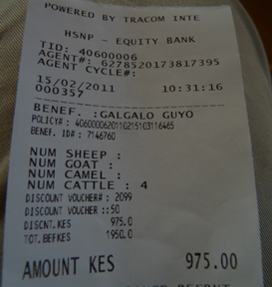
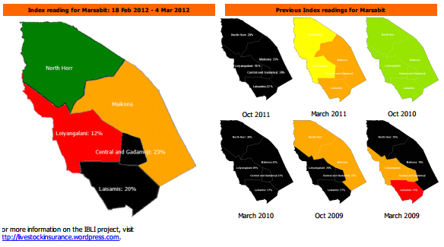
(Jensen, Barrett &2014)
How? Pilot study implementation
Commercial underwriters: In Kenya: UAP, APA, Takaful. In Ethiopia: OIC
International reinsurers: Swiss Re, Africa Re, Zep Re
Lots of implementation challenges (Johnson et al. JDS 2019)
IBLI team developed extension/financial education to
(randomly) inform and educate prospective buyers.
Payouts have occurred (largely) as designed! ☺

Slide 8
IBLI’s Positive Short-run Impacts
IBLI coverage:
Increases vet expenditures, milk income/TLU, total hh income, child MUAC; income and milk production in drought years.
Marginal impact on income or MUAC is 6-45x that of HSNP cash transfers!
Reduced distress livestock sales, herd losses, slaughtering and meal skipping in response to indemnity payments
Reduced non-drought herd size in Kenya (reduced precautionary savings?), increased non-drought herd size in Ethiopia, esp. near herd size threshold
Initially reduces herding effort, which then recovers as herders learn IBLI
Increases subjective well-being by far more than buyer’s remorse effects of lapsed insurance that doesn’t pay out.
Crowds in informal transfers within communities, addressing basis risk issues and perhaps reinforcing traditional conflict resolution/social solidarity.
Jensen, Barrett & Mude JDE 2017; Toth et al. 2018; ; Janzen & Carter; Tafere, Barrett & Lentz; Takahashi, Barrett & Ikegami - all AJAE 2019; Gebrekidan et al. CRM 2019; Matsuda et al. GPRI 2019; Noritomo & Takahashi JDS 2020

Slide 9
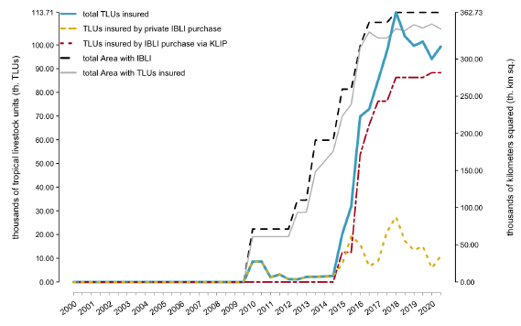
IBLI scale-up within original AOI
After initial Marsabit (Kenya) pilot, adapted for OIC in Borana (Ethiopia), then developed sharia-compliant version for Takaful in NE Kenya.
Kenya gov’t took nationwide through Kenya Livestock Insurance Program
WFP adopted IBLI in Ethiopia (Somali) and Zambia.
World Bank DRIVE project across Djibouti, Ethiopia, Kenya, Somalia
Kenya, Mauritania use for sovereign drought insurance via ARC

Slide 10
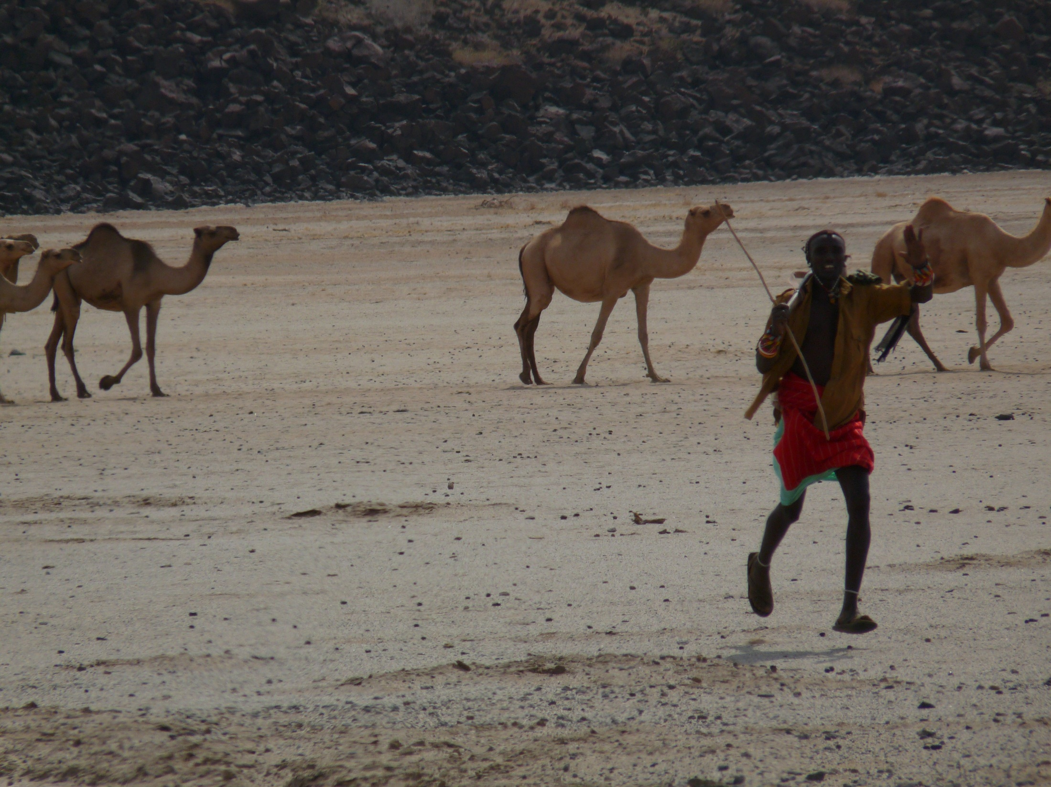
IBLI offers a promising option for addressing poverty traps that arise from catastrophic drought risk … and impacts/$ > cash transfers
Thank you for your time, interest and comments!
Notes:
10

